Slide 1
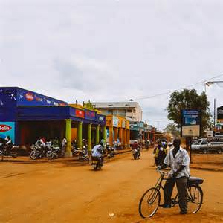
COSIER ORPHANAGE
Jinja, Uganda
2014

Slide 2




A Sustainable Development Project
In Conjunction with
And many more generous individuals from around the world!

Slide 3
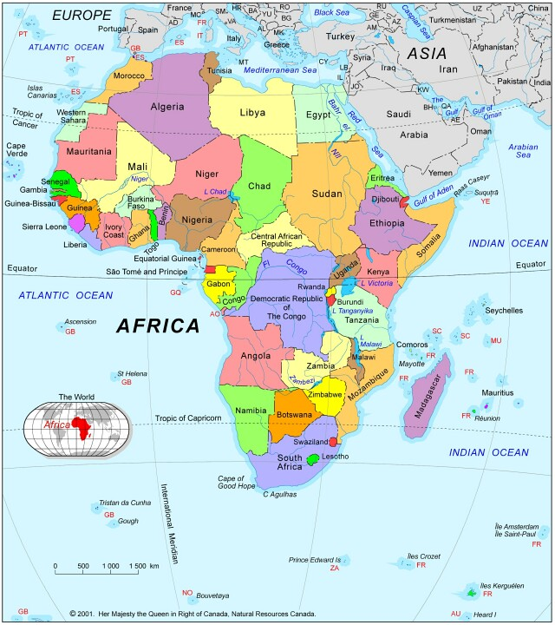
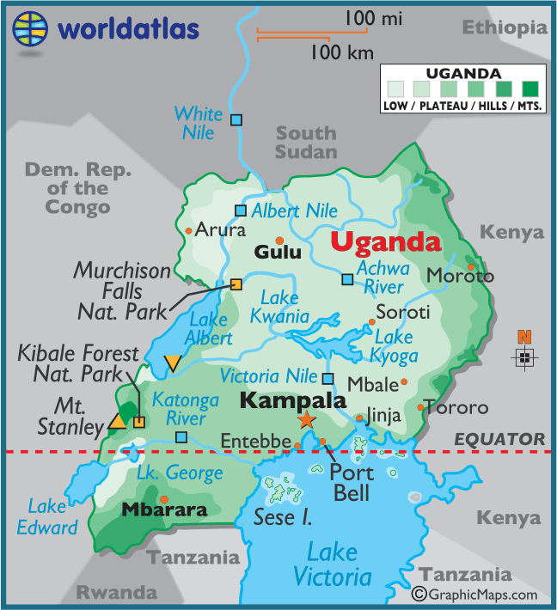

Slide 4
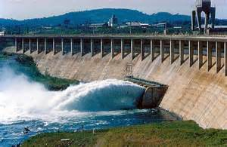
Jinja, Uganda
Located near the source of the world's longest river—the Nile, what began as the quaint fishing town of Jinja, Uganda, was colonized in 1907 by the British as an industrial center for the country defined by its access to waterways and the railroad. The lush and arable land lent itself naturally to an abundance of crops such as tobacco, sugar, cotton, and tea. In the 1950s, engineers transformed the area once again by building the Owens Fall Dam making Jinja the main regional source of hydroelectricity.

Slide 5
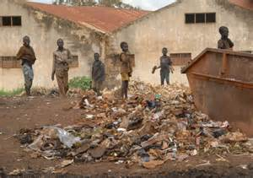
Jinja, Uganda Con’t
Today, the city of Jinja, in the Busoga District, has a population of approximately 110,000. A major commercial and industrial hub with fertile soil, abundance of water and access to waterways and railroad, the city is also a mecca for tourists due to its geographic amenities popular with water thrill seekers. Despite this, the Busoga District is the 2nd poorest in Uganda. Without adequate infrastructure for the people, access to potable water, insufficient housing, healthcare, and education is almost impossible creating a situation of extreme poverty in the outlying rural areas of the city.

Slide 6
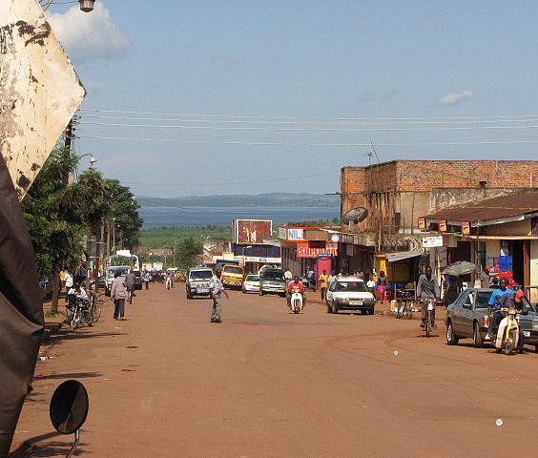
Jinja, Uganda
East Africa

Slide 7
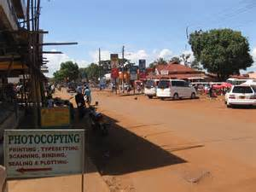

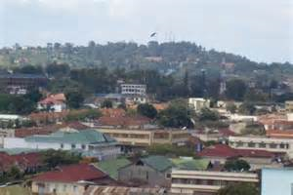
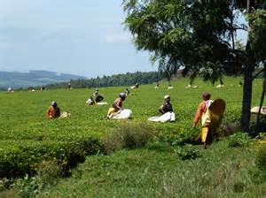
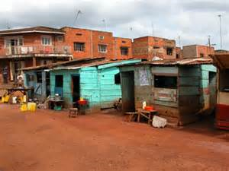

Slide 8
HISTORY
Home to approximately 25 orphans, at any given time, ages ranging from 4 to 15 years old, the orphanage is a mecca for children who have lost their parents to AIDS. Many of the children are also suffering from this ravaging disease.
Since opening its doors in 2008, COSIER has struggled with providing the basic necessities of adequate housing, food, clothing, education, and medical assistance to the children.
Jeremiah Mikenga, Project Manager and Director, realized that getting by on donations was not going to sustain his dream of providing a home for these children who are often left on their own to survive once their parents have passed. So, in 2013, he “hatched” an idea to make the orphanage financially self-efficient.

Slide 9

DO YOU LIKE CHICKENS?
Source: Clovis Long of Mustache Power Productions in Pleasant Grove, Utah, 2014.

Slide 10
COSIER POULTRY FARM
Stages of Sustainable Development
Incubation
(Initiation Phase)
Build
(Build Phase)
Roosting
(Pilot Phase)
Hatching
(Expansion Phase)
Production
(Growth Phase)

Slide 11
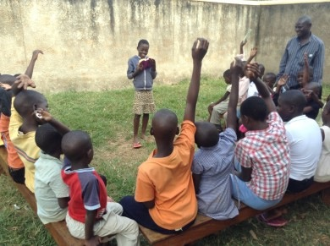
INCUBATION PHASE
Director Mikenga and the children “hatch” an idea to start a poultry farm to become self-sufficient. They will raise chickens and sell the eggs at market.

Slide 12
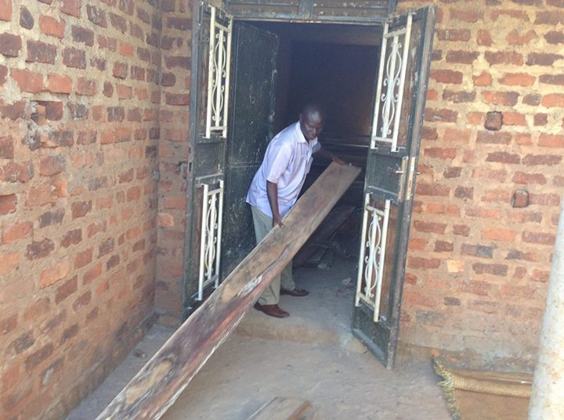
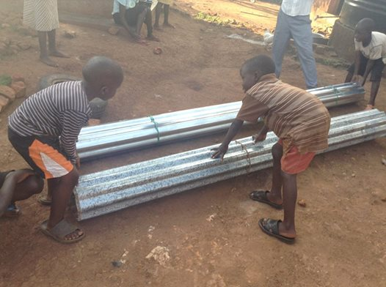
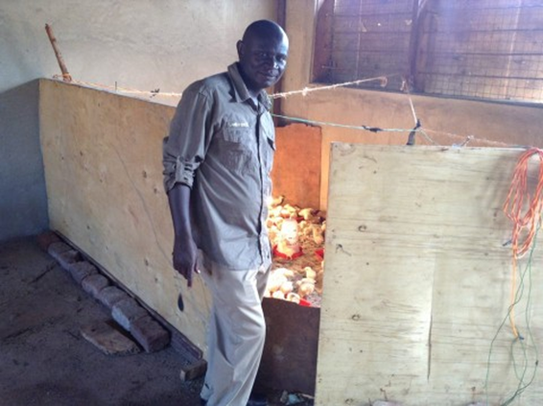
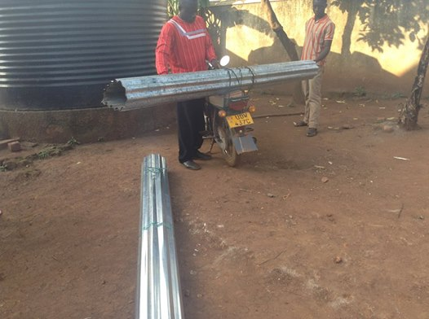
BUILD PHASE

Slide 13
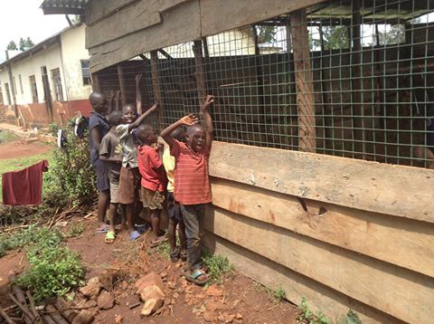
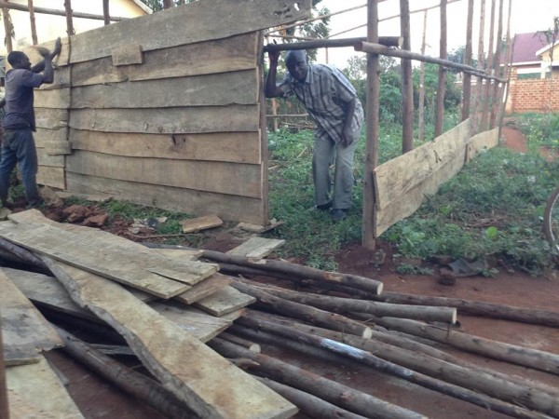
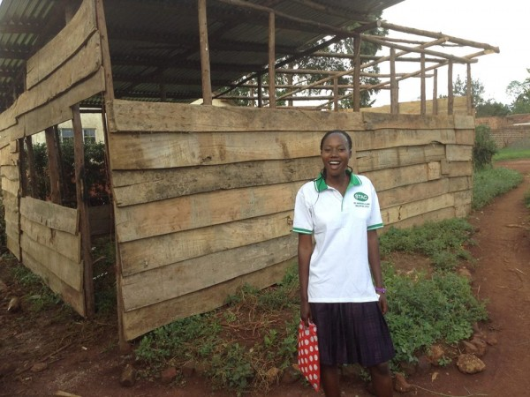
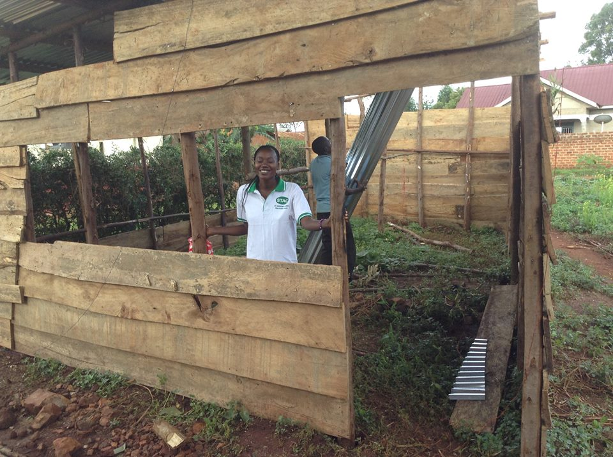
BUILD PHASE

Slide 14
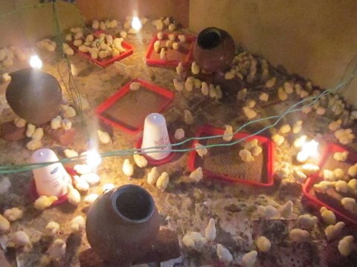
ROOSTING PHASE
200 CHICKS HAVE ARRIVED

Slide 15
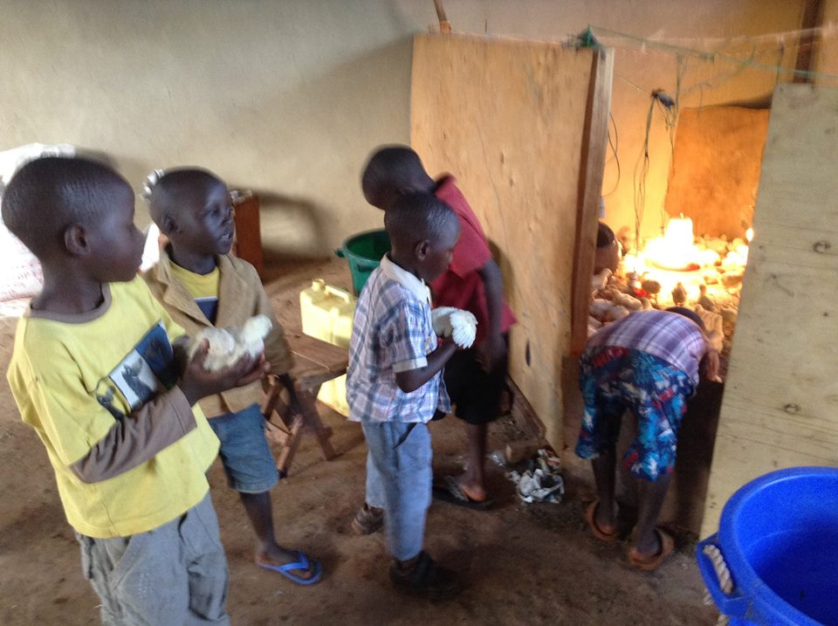
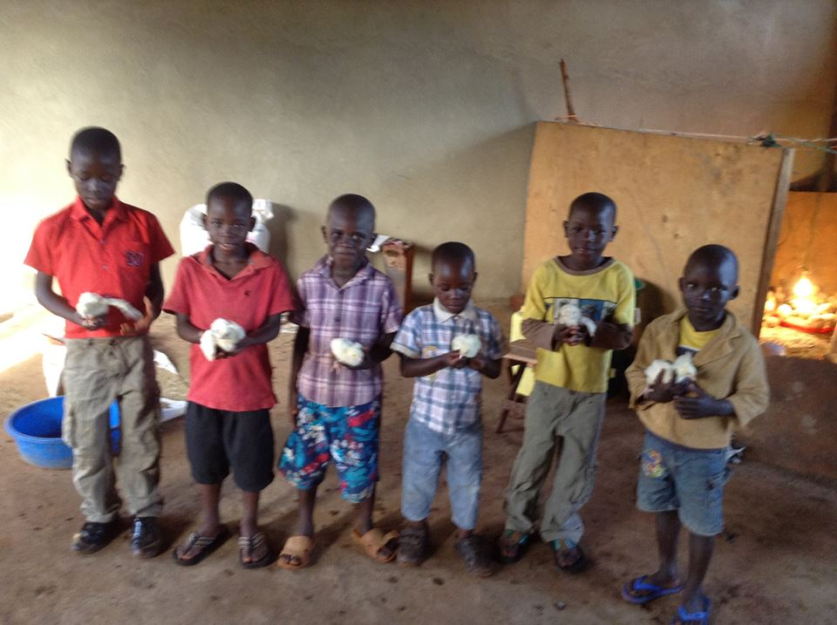
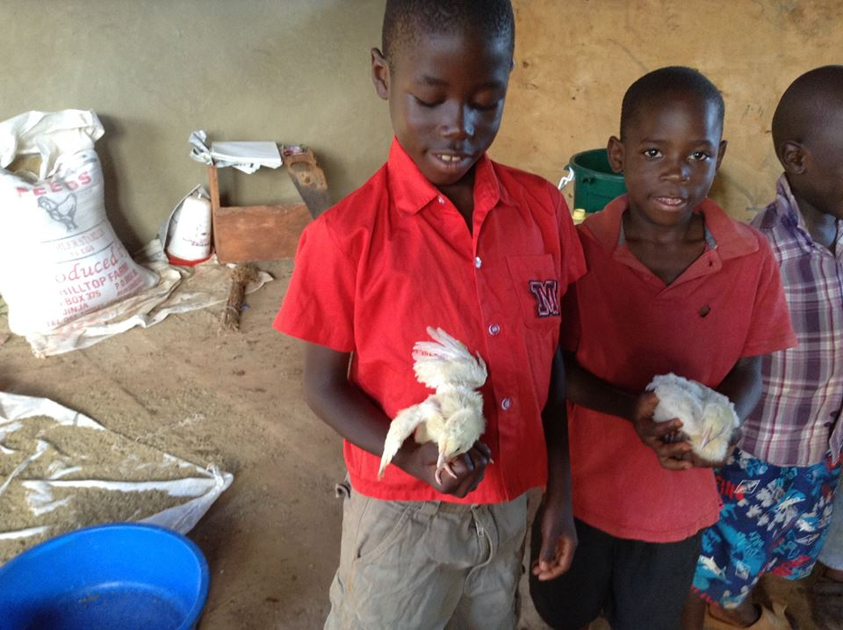
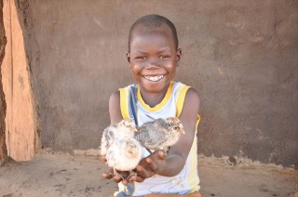
HATCHING PHASE

Slide 16
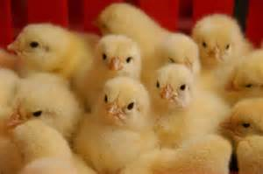

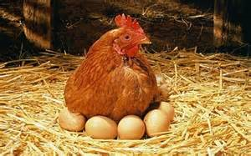

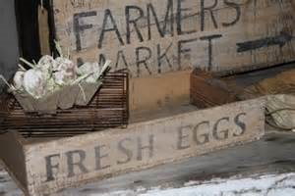
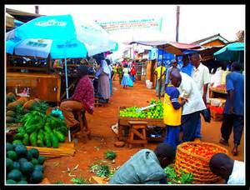
PRODUCTION PHASE

Slide 17
MOVING FORWARD
STILL NEEDED:
Poultry Farm:
  Chicken Feed
  Egg Cartons
Clothing
Education
  School Fees
  School Supplies
  Uniforms
Healthcare:
  Vaccinations
  Deworming

Slide 18
FUNDS RAISED BY SOUTHWIND HIGH SCHOOL KIVA CLUB – MEMPHIS, TN
Southwind KIVA Club raised $515.00 in 5 months.
Our club was successful in helping to raise a total of $3,100.00 on Face Book along with Brighter Brains Institute and numerous generous individuals and organizations.
We are currently raising another $150.00 to send dresses to the children.
We have sent hand-written postcards from Memphis to each of the children along with photos.
We have sent a copy of the book One Hen—a true story from Ghana about a boy who started a poultry business—to inspire the children.

Slide 19

CAN WE DO THIS?
COSIER Orphanage needs support for at least another year to continue their goal of reaching self-sufficiency through education, healthcare, and entrepreneurship.

Slide 20
